Slide 1

4. Spectral Vectors and Angles
Dr. David R. Thompson
Jet Propulsion Laboratory, Imaging Spectroscopy Group
July 20, 2019

Slide 2
Goals for this module
Use the spectral angle mapper to identify coral in Kahneoe Bay.

Slide 3
Imagine each spectrum is a vector, e.g. a point in d-dimensional space, represented by d numbers each.
An image cube becomes a data cloud of points.
… now generalize this idea to 400 channels. We can’t visualize this, but the same mathematical tools apply.
spectra
Channel 2
Channel 1

Slide 4
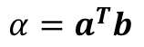
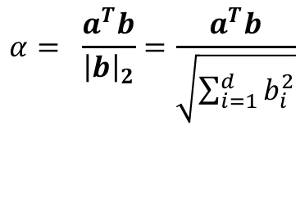
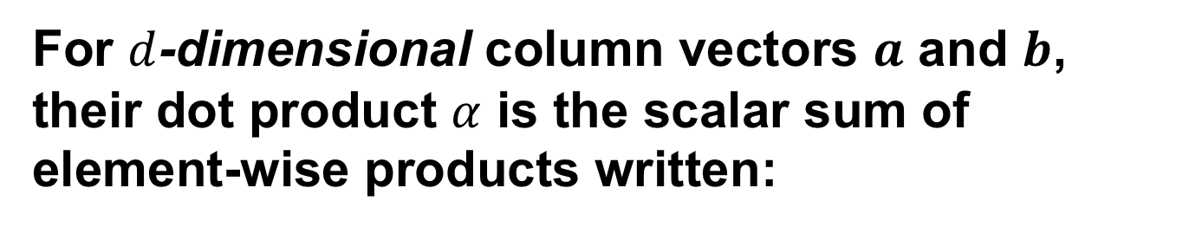


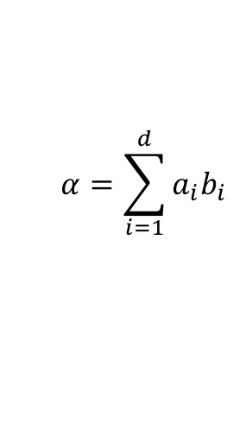
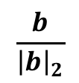
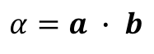
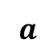
For $d$-dimensional column vectors $a$ and $b$, their dot product $α$ is the scalar sum of element-wise products written:
$$α=\sum_{i=1}^{d}{{a_{i}b}_{i}}$$
$$α=a ∙ b$$
alternatively,
$$α=a^{T}b$$
alternatively,
If $a$is normalized, this is the magnitude of the orthogonal projection of $b$ onto $a$:
$$a$$
$$\frac{b}{{\left|b\right|}_{2}}$$
$$α= \frac{a^{T}b}{{\left|b\right|}_{2}}=\frac{a^{T}b}{\sqrt{\sum_{i=1}^{d}{b_{i}^{2}}}}$$
$$α$$
It describes the similarity between $a$and $b.$

Slide 5
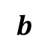
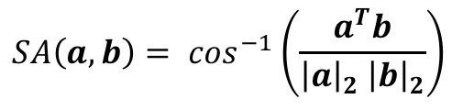
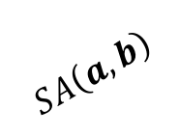
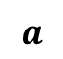
The spectral angle relates to the arccosine of the normalized dot product. It describes the angle between two high-dimensional vectors.
$$a$$
$$SA\left(a,b\right)= \cos^{−1}\left(\frac{a^{T}b}{{{\left|a\right|}_{2} \left|b\right|}_{2}}\right)$$
$$b$$
$$SA\left(a,b\right)$$
It quantifies the match between spectral shapes shapes, and is invariant to vector magnitudes.

Slide 7
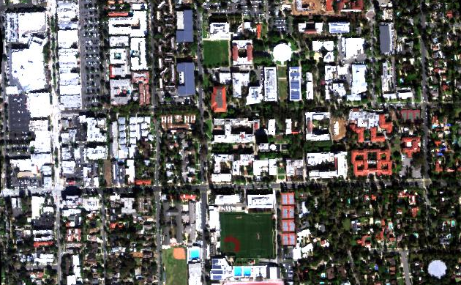
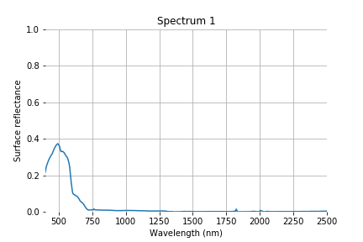
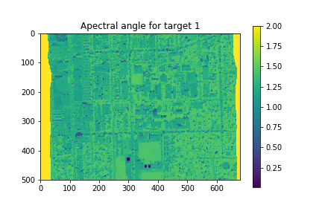
Exercise 2: Spectral angle mapping
Full spectrum data cube
Target signatures (1 of 12)
Spectral Angle Calculation
N
100 m
Objective: Automate the scavenger hunt!
Calculate the spectral angle map for every target signature.
Save a map for each answer. Does it match your intuition?
Spectral angle for target 1

